Slide 1
EE422C
Software Implementation II
Exceptions

Slide 2
Exception Handling
An exception is a run-time error - you can handle it or let the JVM handle it
Exceptions can cause a program to crash OR they can be caught and handled by your program, hopefully recovering gracefully.
Exception handling - using the features of the language to manage run time errors in an orderly fashion

Slide 3
Goals
To learn how to catch exceptions
To know when and where to catch an exception
To learn how to throw exceptions
To be able to design your own exception classes
To understand the difference between checked and unchecked exceptions

Slide 4
Why Use Exceptions?
Separate normal from exceptional behavior
  For example, what to do if a function’s precondition is violated
We want to separate Error Handling Code from Regular Code
  So that frequent and repetitive testing of return values, and propagation of error return values, is not required.
  Using exceptions may be more efficient because the normal execution path does not need to test for error conditions.

Slide 5
Why Use Exceptions?
Necessary for reliable, fault tolerant, robust software systems
  Often 75%+ code dedicated to reliability
  20% of interface errors are errors in handling exceptions
We want to manage run time errors in an orderly fashion so as to create fault tolerant software systems
  If an exception is not caught, the program terminates.
  Advanced error handling can be done that allows for resumption of execution after correcting for an error
  Capability to return error information is not limited to just the return type of an operation.

Slide 6
Exception Handling Options
What to do about exceptions
  Preclude
    Guarantee they do not happen
  Report
    Up to someone else to do something
  Retry
    Works when fault is transient
  Repair in situ
    Fix the problem or compensate for the problem
  Ignore
    Results are satisfactory even with the exception

Slide 7
Why Exceptions - Details
We want to propagate Errors Up the Call Stack
  The point at which an error occurs is rarely a suitable place to handle it, particularly in library code, but by the time an error code has been propagated to a place where it can be handled, too much contextual information has been lost.
  Exceptions bridge this gap - they allow specific error information to be carried from the point where its available to a point where it can be utilized (using exception objects that contain the information).

Slide 8
Exception Handling Mechanics
An exception is an abnormal condition that arises in a code sequence at run time (i.e., a run time error)
JAVA has built-in exception handling features for certain exception object types
Exception object - is created when the error occurs and contains information about it
Exception handling is accomplished by the keywords: try, catch, throw, throws, and finally
    Exceptions and Exception Types
    Claiming Exceptions
    Throwing Exceptions
    Catching Exceptions
    Rethrowing Exceptions
    The finally Clause

Slide 9
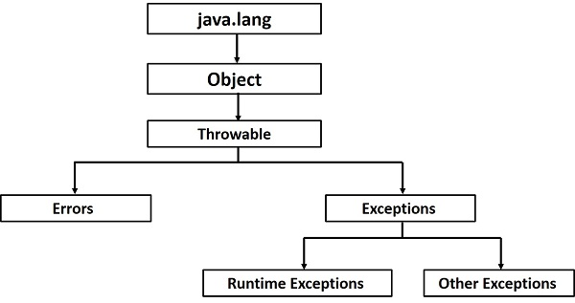

Slide 10
Exception Handling Block
try {
// block of statements to be monitored
}
catch (ExceptionClass1 exceptionObject) {
// block of statements that handle exception type 1
}
catch (ExceptionClass2 exceptionObject) {
// block of statements that handle exception type 2
}
finally {
// block of final statements to be done
// in any and all cases
}

Slide 11
Exception Control Flow
When an exception is thrown, the method containing the throw statement doesn't necessarily return immediately to its caller
Instead, the closest matching catch clause is located and executed, and then the corresponding finally clause is executed
If there is no matching catch clause, the program terminates

Slide 12
Catching Exceptions - Example
static void exceptionExample() {
  int a = 0, b = 0, c = 0, n = 0;
Scanner in = new Scanner(System.in);
  try { // block of code to be monitored for exceptions
    String s;
    a = 356 / n;
    s = in.next();
    b = Integer.parseInt (s);
  }
  catch (ArithmeticException e1) { //catch arithmetic run time errors
    System.out.println ("divide by zero attempted"); a = 0;
  }
  catch (NumberFormatException e2) {
    //catch invalid conversions of a string to a numeric format
    System.out.println ("invalid number in string"); b = 0;
  }
  finally { //do this block regardless
    c = a + b;
    System.out.println ("the value of c is " + c);
  }
}

Slide 13
Throwing Exceptions - Hints
It is not necessary to catch all exceptions
If you don't know how to handle an exception, don't catch it
You can throw them yourself
When an exception is thrown, method terminates immediately
  Execution continues with an exception handler
public void deposit(double amount) {
  if (amount < 0) throw new IllegalArgumentException("cannot deposit negative amount");
  balance = balance + amount;
}

Slide 14
Example bad use of exceptions
[Bloch, Effective Java, Item 39]
Do not use exceptions for normal control flow
E.g., do not use
  try {
  int i = 0;
  while (true)
  a[i++].f();
  } catch(ArrayIndexOutOfBoundsException e) { }
Instead of
  for(int i = 0; i < a.length; i++) {
  a[i].f();
  }

